Slide 1
The global superstore Data analysis
CREATED BY: KSHITIJ VALAVIL
PRESENTATION: Technical
DATE: 1/01/2021

Slide 2
About the company
The global superstore is an e-commerce platform with a large variety of products with a revenue base of $1.4 billion. They sell to majorly the consumer and corporate segments and have a large customer base in multiple countries.
The Management has expressed that they would like to increase the profits by increasing sales in countries, decreasing costs by choosing alternate shipping methods and divestment of products by the next year.

Slide 3
Increase in revenue and demand also increases the risk of returned orders and higher cost of shipping. Profits declining in high Monetization regions due to poor performing products have caused a dampener in the organizations potential profit goals.
Increased sales and revenue have increased profits but have lost a chunk due to losses in certain segments | Top performing items and regions have more costs due to wrong shipping and low order quantities.
Some categories fair poorly due to certain amount of products | Furniture section has an impact of 52% loss on its profits due to its products.
Incorrectly aligned shipping causes customer to assort to the cheapest shipping with more cost to comapy | Shipping like same day and First class have order priority medium which is creating 10% more cost and customer pays less making profit on his single order.

Slide 4
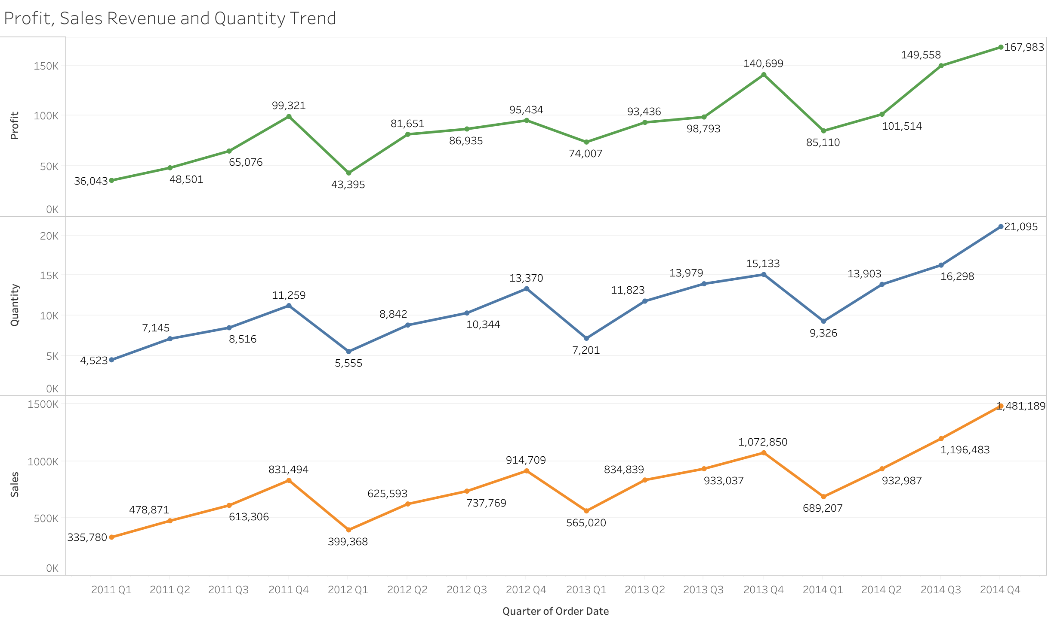
Increase in profits (20%) and Sales revenue (38%) and to keep cost at a minimum ,targeting a set of customers with high monetization capacity, through targeted management, increasing sales in high demand countries/ market region, decreasing costs by choosing alternate shipping methods and divestment of products wiLl be done to improve segmented Profit by 10%

Slide 5
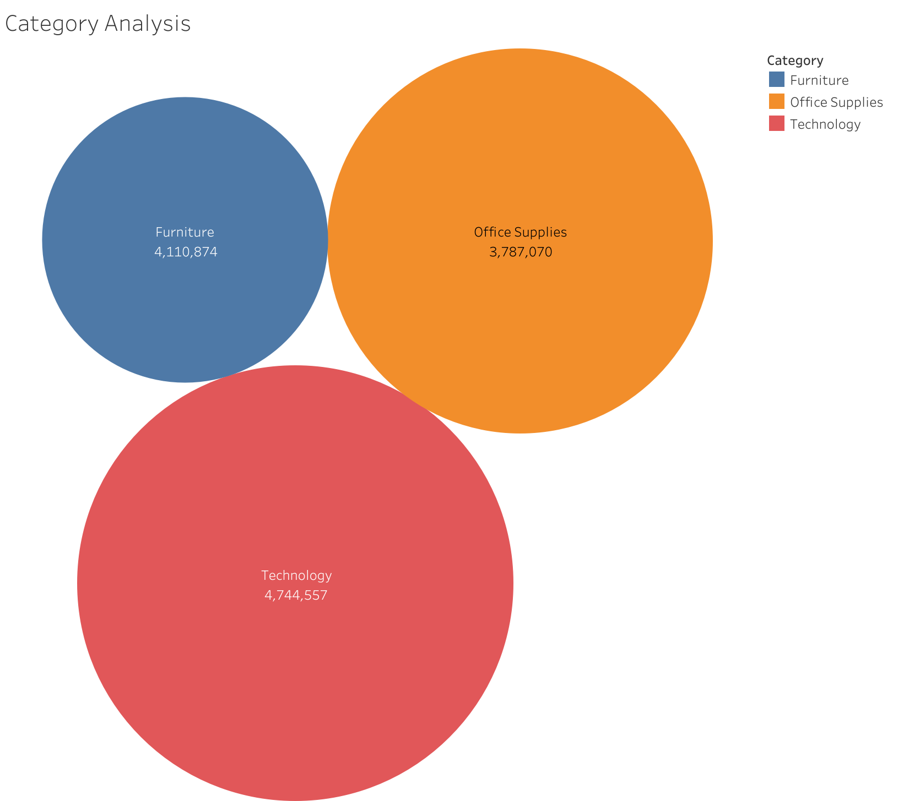
Categorical Analysis
Key Insights
Furniture has a low profit even with the high performance in sales, product analysis will reveal what products makes negative profit
Tech and Office supplies are generating maximum profit in customer segments like Consumer and Corporate.

Slide 6
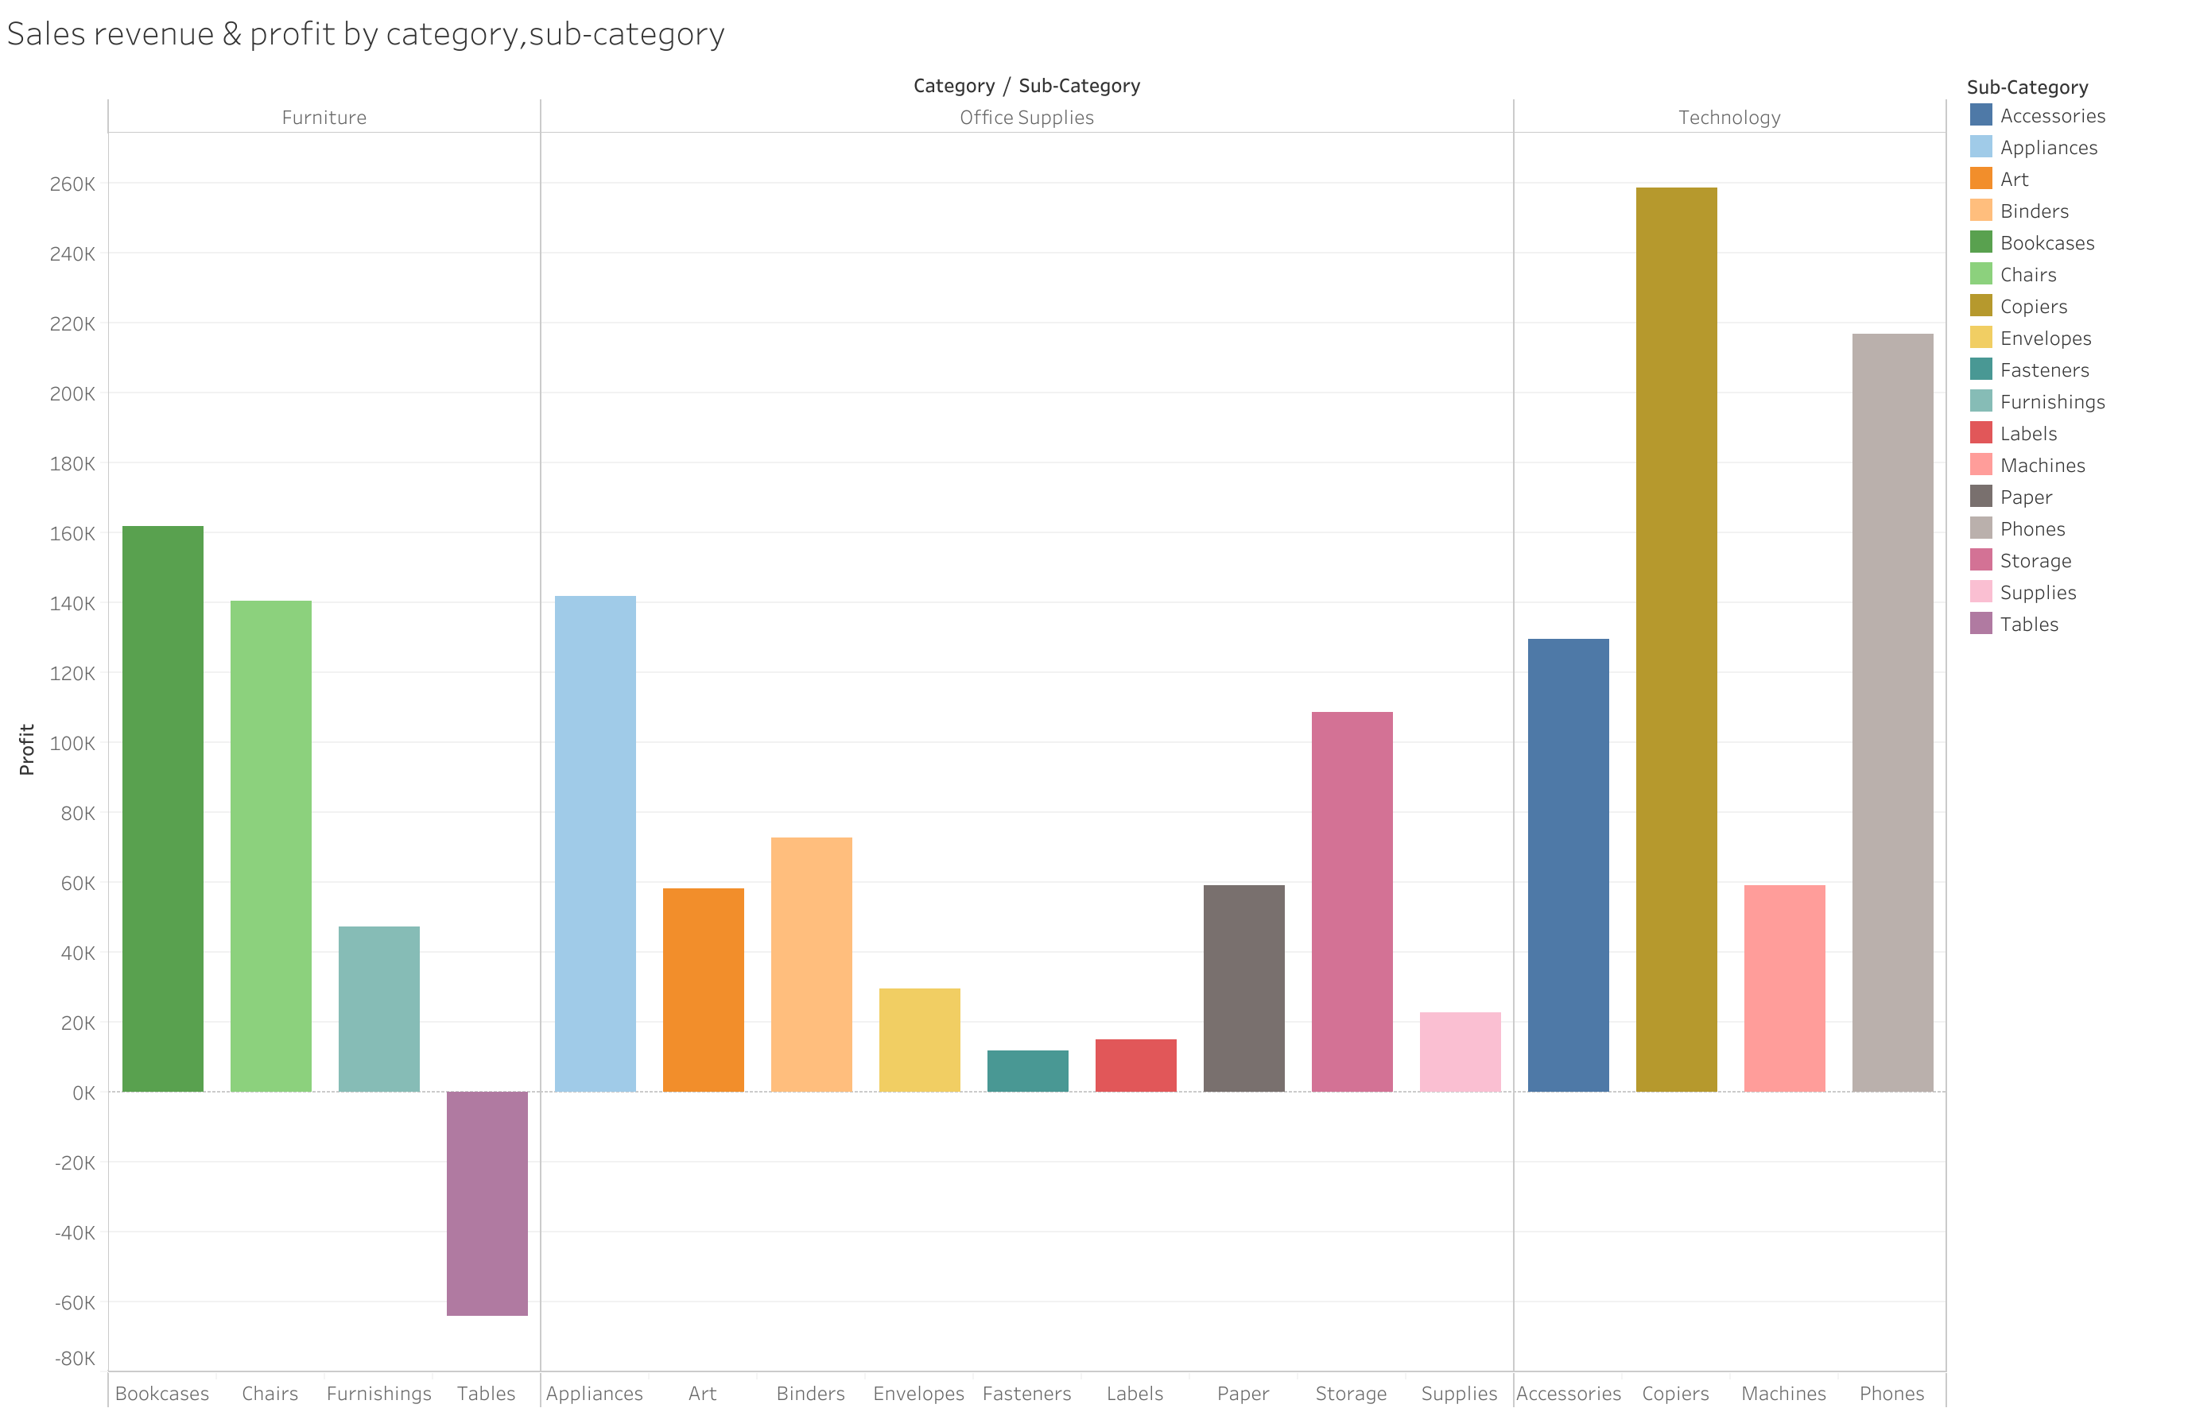
Analysis of Sales revenue & profit BY sub-Category
Key Insights:-
All the categories are performing well in terms of revenue generation.
The subcategory Tables, generating revenue is having a negative impact (52% loss) due to reasons such as high shipping cost, product being returned, product damage , etc.

Slide 7
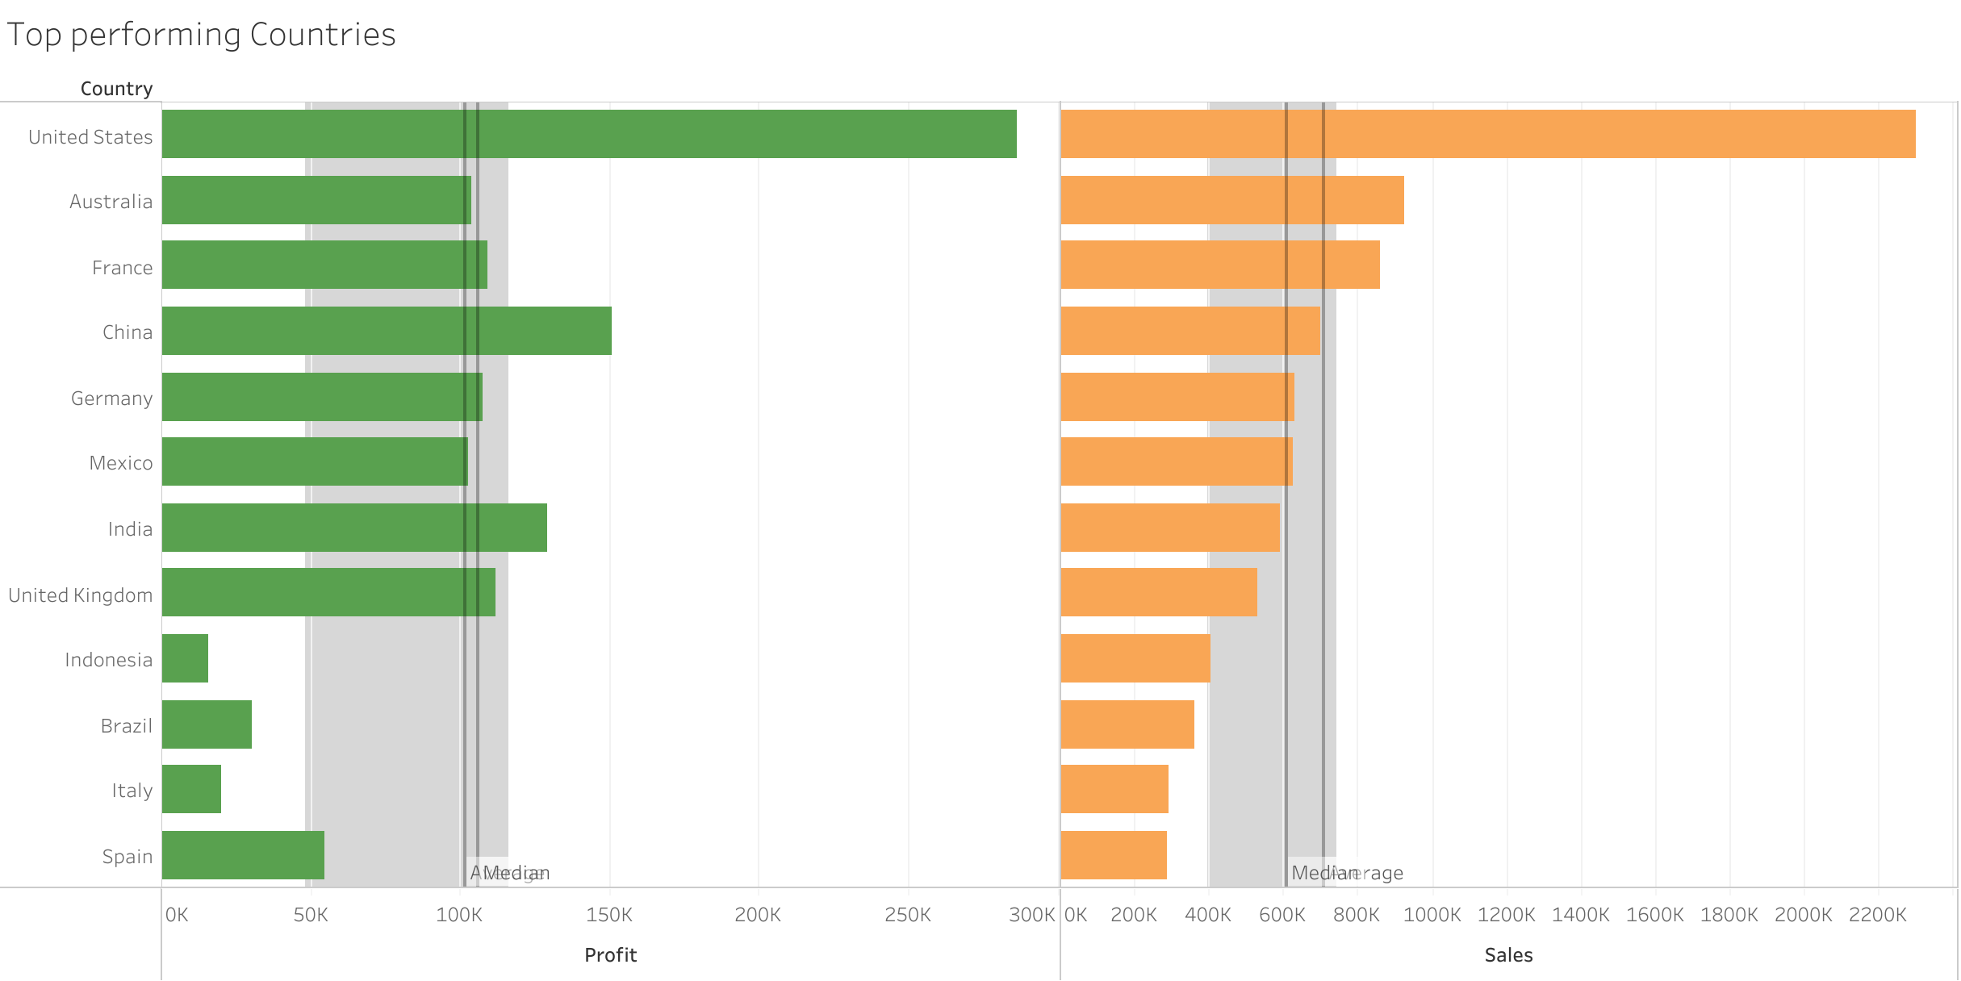
Top Performing countries
Key Insights
The top performing country, USA , has a revenue of $2 million is managing a a very low profit of $200 thousand.

Slide 8
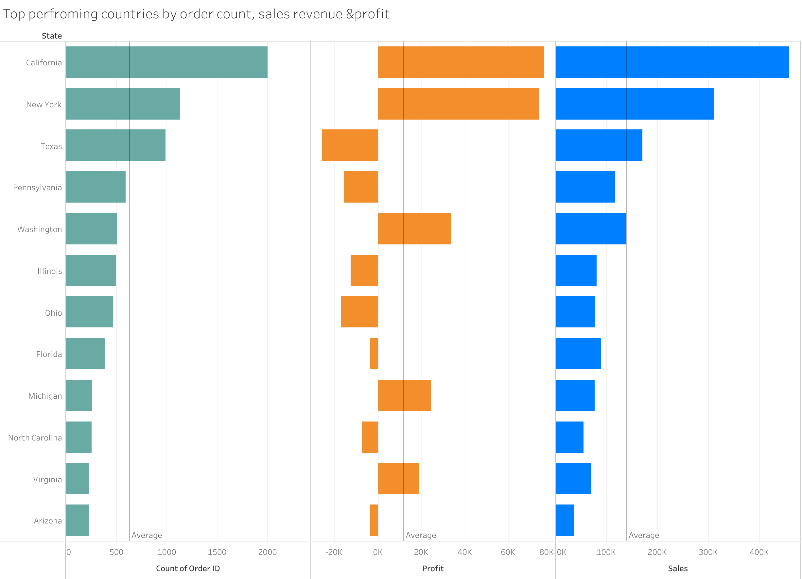
Profit analysis BY states
Key Insights
States such as California have maximum number of orders which account for their profits.
States like Texas, Pennsylvania has negative profits due to factors such as high shipping cost and returned orders

Slide 9
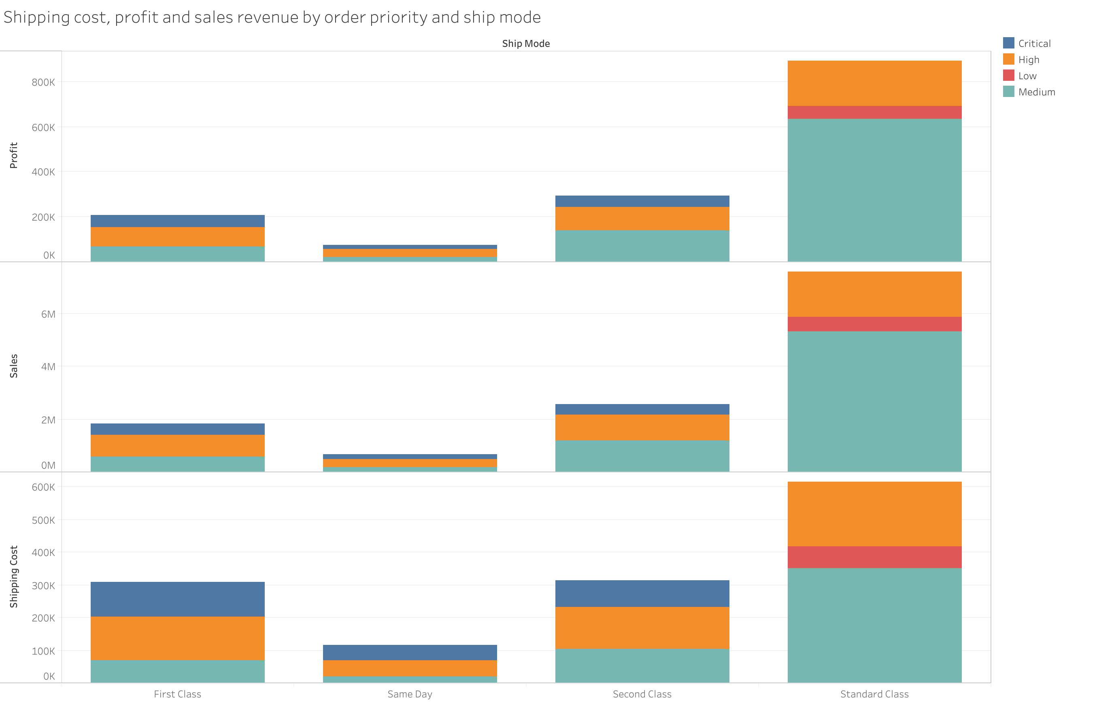
Shipping cost & Order Priority analysis
Key Insights
The ship mode First class and Same day have order priority as Medium which does not suit the nature of the deliver, causing to incur more cost with minimal delay in delivery.
The order priority if high should not have delivery mode as Standard as it again incurs more cost to the organization.

Slide 10
CONCLUSION
The country USA with the highest profitability margin has states with the above average order count in Central America market region having a huge negative impact on the overall profits.
This can be avoided by doing individual state to order analysis and inventory management with targeted sales to high monetization customers with perks like higher discount rates for maximum quantity order placed and reorders.
Returned order policy must be revamped to keep accountability of all the product retailers.

